Slide 1
The Best Neighborhood To Open a Diagnostic Centre
Battle of Neighborhoods (The City of Toronto)

Slide 2
The Problem
A Group of Medical Practitioners (Medical Laboratory scientists) decides to move their abode from an African Country to the city of Toronto. They intend to arrive in Toronto and establish various medical diagnostic centers (Medical laboratories) across various Neighborhoods in the city of Toronto. Faced with the difficulty of selecting the best and most favorable neighborhood out of 140 neighborhoods in the city of Toronto, they employed the help of a Data scientist.
The Top factors to be considered in choosing the most favorable neighborhoods are: neighborhood with low amounts of already established medical diagnostic centers/Medical laboratories, neighborhood with a high number of Hospitals around, neighborhood with a high population and neighborhood with a low crime rate.

Slide 3
Data sets used to solve the problem
The main dataset is the number of medical laboratories and Hospitals per Neighborhoods which was obtained using the foursquare api.
Other Data set essential for the solving of the problem was gotten from https://edu.hub.arcgis.com/datasets, this includes data sets of toronto neighborhoods, population, crime-rate etc.

Slide 4
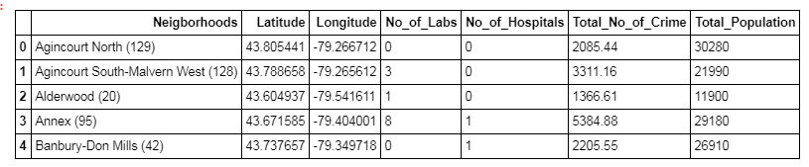
first five rows of the wrangled and pre-processed data-set
After acquiring all necessary data-set, the data-sets were cleaned and pre-processed. The picture above shows the first five rows of the wrangled and pre-processed data-set which is now ready for the next stage of the project; clustering

Slide 5
Machine learning algorithm
A clustering algorithm (K-Means) was used in selecting the best neighborhoods.
WHY KMEANS ?
Since the aim of the project is to select the best neighborhood that meets the criteria listed above, a clustering is done to group the neighborhoods. With kmeans, neighborhoods with similar traits fall into same group and the group that best suites our best neighborhood description is chosen

Slide 6
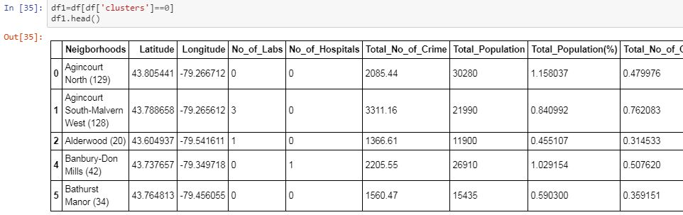
First five row result of cluster 0

Slide 7
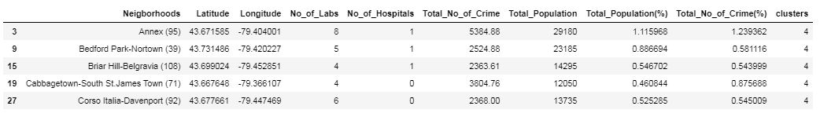
First five row result of cluster 4

Slide 8
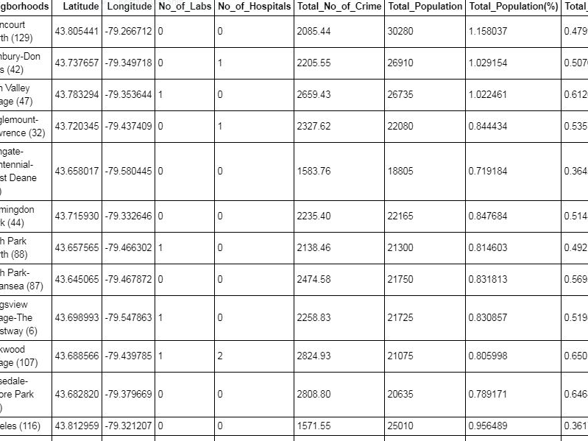
18 better neighborhoods from cluster 0
Cluster 0 best fit our search and is selected for further analysis, to give 18 better Neighborhoods.

Slide 9
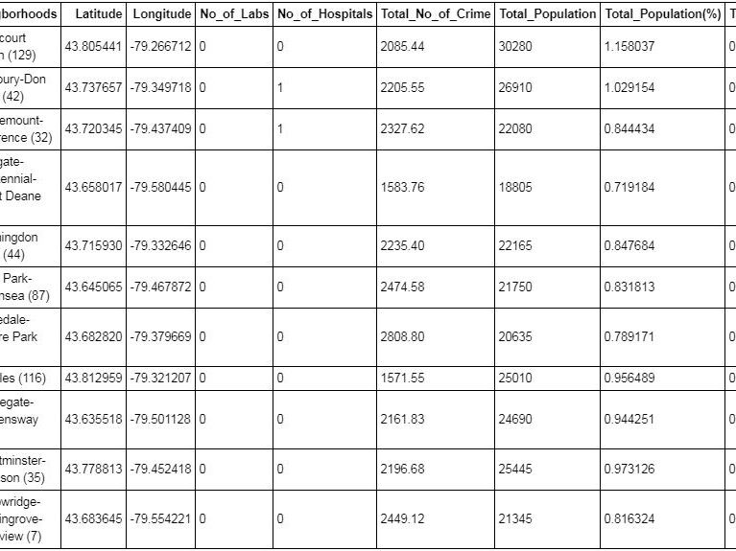
The Finally selected 11 Best neighborhoods
The 18 better neighborhoods were further processed to give 11 best neighborhood

Slide 10
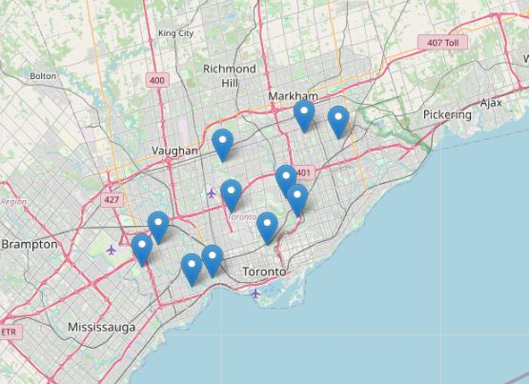
Visualization
A folium map visualization of the 11 best neighborhoods

